Slide 1
TIC TAC TOE GAME
Using HTML, CSS, and JavaScript
Presented by:
RAJESHWARI D
R.M.D ENGINEERING COLLEGE

Slide 2
Introduction
🎯 What is Tic Tac Toe?
A classic two-player game.
Players take turns marking X or O in a 3×3 grid.
The goal is to place three marks in a row – vertically, horizontally, or diagonally.
🎯 Our Project Goal:
To design and develop an interactive Tic Tac Toe web app.

Slide 3
Technology Stack
🛠 Technologies Used:
HTML – Structure of the game
CSS – Styling the UI
JavaScript – Game logic and interaction
Optional Tools:
VS Code
Live Server Extension

Slide 4
Project Structure
📁 Project Files:
• index.html – Main layout
• style.css – Custom styling
• script.js – Logic for gameplay

Slide 5
Features
✨ Key Features:
✔️ Interactive 3x3 game board
✔️ Turn-based player logic
✔️ Win/draw detection
✔️ Restart button
✔️ Stylish and responsive UI

Slide 6
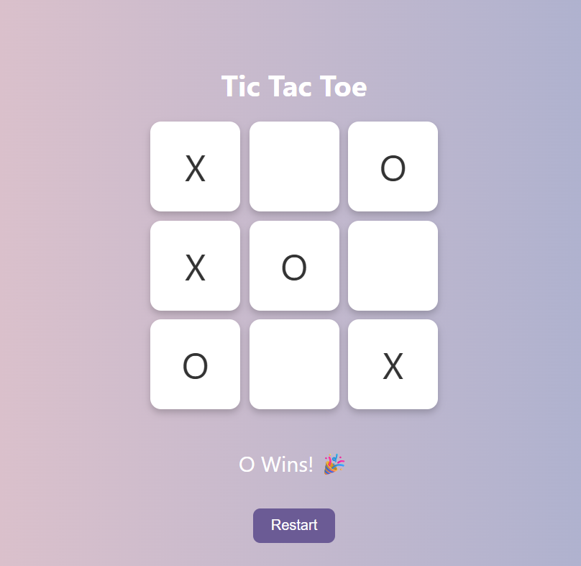
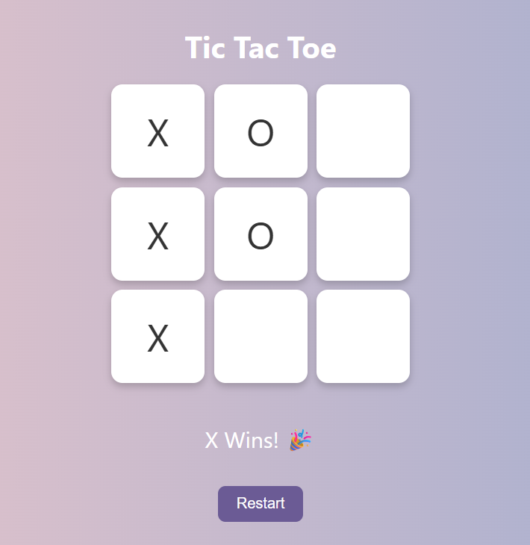
User Interface (Screenshot)

Slide 7
How It Works
⚙️ Game Flow:
1. Player clicks a cell.
2. Mark (X or O) is placed.
3. JS checks for win or draw.
4. Result is displayed.
5. Restart button resets the game.

Slide 8
JavaScript Logic (Brief Code Snippet)
function checkWin(currentClass) {
return WIN_COMBOS.some(combo => {
return combo.every(index => {
return cells[index].textContent === currentClass;
});
});
}

Slide 9
Challenges Faced
⚠️ Challenges:
• Managing turn-based logic
• Detecting win conditions
• Resetting board dynamically
• Designing mobile-responsive layout

Slide 10
THANK YOU

